Slide 1
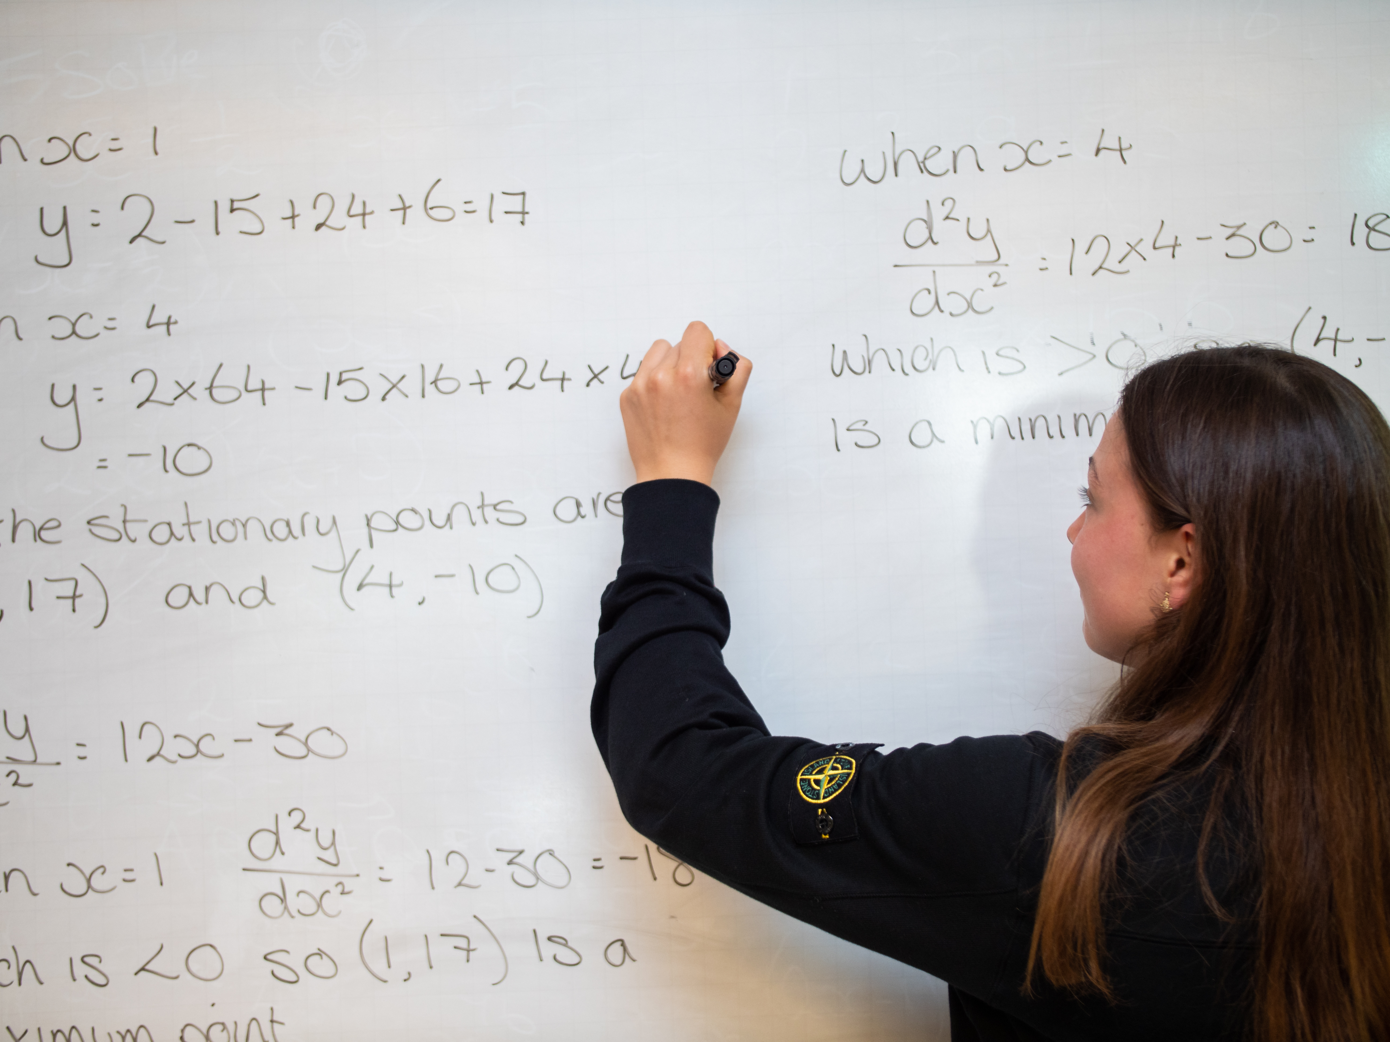
A Level Mathematics L6
6
Mathematics teachers are striving for all students to develop an interest in studying the subject at a higher level. Students will be encouraged to explore the links between mathematics and other fields of study. Students will develop an awareness of the relevance of mathematics to the world of work and to situations in society in general.
Mathematics knows no races or geographic boundaries; for mathematics, the cultural world is one country.- David Hilbert
Students will learn:-
Autumn Term
Algebraic expressions
Quadratics
Equations and inequalities
Graphs and transformations
Coordinate geometry in cartesian plane
Algebraic methods
Binomial expansion
Data collection, sampling
Measures of location and spread
Representations of data
Correlation
Modelling in mechanics
Spring Term:
Trigonometric ratios
Trigonometric identities and equations
Vectors (2D & 3D)
Differentiation and integration
Probability
Statistical distributions
Kinematics -constant acceleration
Forces and motion (Newton’s laws)
Summer Term:
Exponentials and logarithms
Proof
Algebraic and partial fractions
Functions and modelling
Series and sequences
✓Statistics
Statistical hypothesis testing
Conditional Probability
✓Mechanics
Kinematics -variable acceleration
Knowledge, understanding & Skills
Understand coherence and progression in mathematics and how different areas of mathematics are connected
Reason logically and recognise incorrect reasoning
Generalise mathematically
Construct rigorous mathematical proof
Use your skills and techniques to solve challenging problems that require you to decide on the solution strategy and communicate the mathematical rationale for these decisions clearly
Recognise when mathematics can be used to analyse and solve a problem in context
Represent situations mathematically and understand the relationship between problems in context and mathematical models that may be applied to solve them
Read and comprehend mathematical arguments, including justifications of methods and formulae, and communicate your understanding
Use technology such as calculators and computers effectively and recognise when your use may be inappropriate
How can you enhance your learning at home?
Pearson Edexcel A-level textbooks (Pure Year 1; Statistics and Mechanics Year 1).
Focus on exam-style questions, problem-solving questions and Mixed Exercises.
Integral resources (online login or published on Shared Drive)
Dr Frost Maths (individual login)
Maths Genie•Zigzag papers•Boardworks presentations
Enrichment: UKMT Senior Maths Challenge
Matriculation requirements:
Grade 7 or higher at GCSE Mathematics. Students that are predicted grade 7 and below are required to attend the GCSE A Level bridging programme in July, completing both this and the summer work to
a satisfactory level.

Slide 2
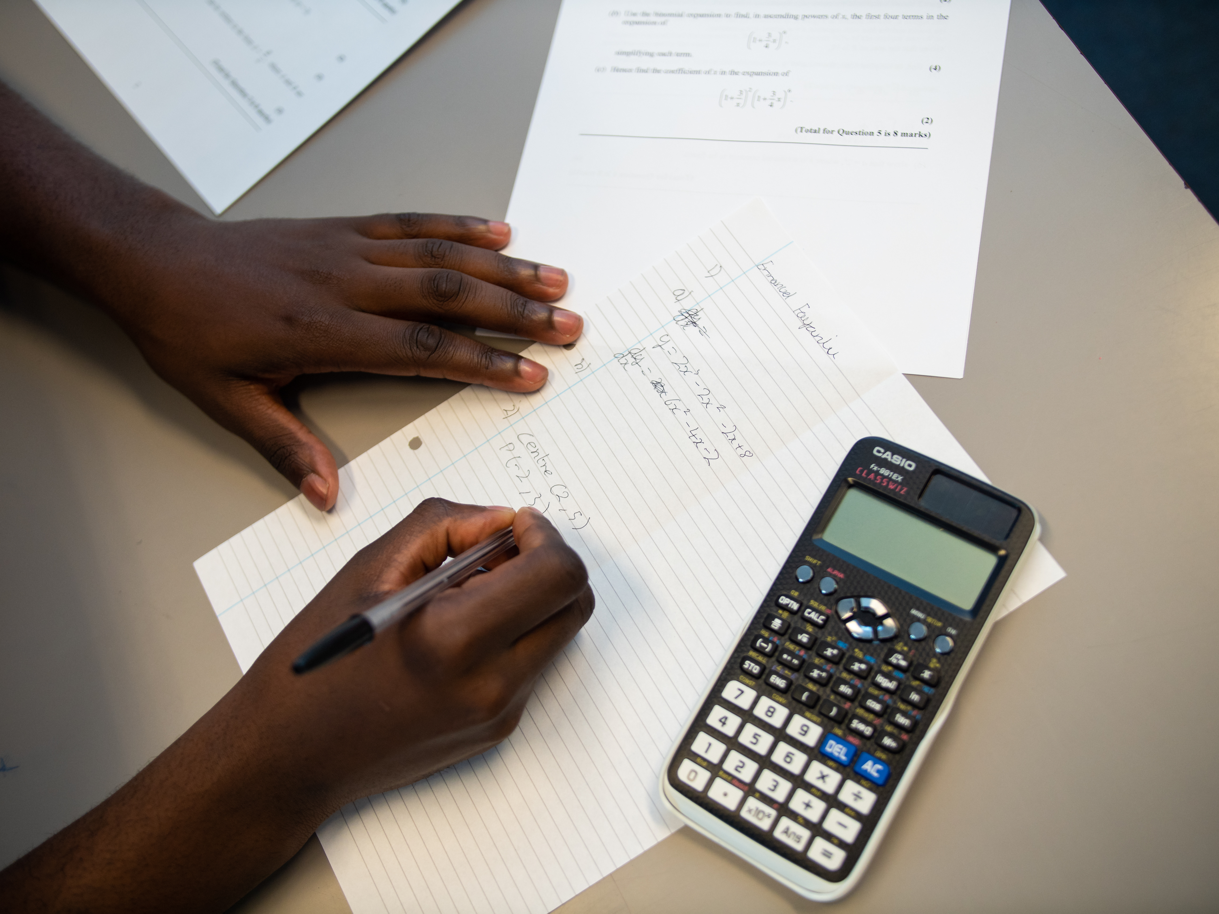
How will we assess impact?
•Exam-style question starters to recap previous work
•Self-assessment
•Peer assessment
•Half-termly unit test
•Integral topic assessment
•Past papers and PPE
Calculator is permitted for all papers. The Casio fx-991 EX ‘Class Wiz’ is a minimum requirement but we recommend the Casio CG50.
What does excellence look like?
Use and apply standard techniques select and correctly carry out routine procedures, accurately recall facts, terminology and definitions
Reason, interpret and communicate mathematically, construct rigorous arguments (including proofs),make deductions and inferences, assess the validity of mathematical arguments, explain your reasoning
Within the curriculum
Mathematical proof was revolutionized by Euclid (300 BCE), who introduced the axiomatic method still in use today. Euclid's book, the Elements, was read by anyone who was considered educated in the West until the middle of the 20th century. In addition to theorems of geometry, such as the Pythagorean theorem, the Elements also covers number theory, including a proof that the square root of two is irrational and a proof that there are infinitely many prime numbers.
Abraham de Moive 1667 – 1754 a French mathematician who invented factorials.
Thomas Jan Stieltjes, (born 1856, Zwolle, Netherlands—died 1894, Toulouse, France), Dutch-born French mathematician who made notable contributions to the theory of infinite series.
Hipparchus of Nicaea (/hɪˈpɑːrkəs/; Greek: Ἵππαρχος, Hipparkhos; c. 190 – c. 120 BC) was a Greek astronomer , geographer, and mathematician. He is considered the founder of trigonometry but is most famous for his incidental discovery of precession of the equinoxes
Wider Reading
Read and comprehend articles concerning applications of mathematics and communicate your understanding
“How to think like a mathematician” by Kevin Houston
“How to study for a mathematics degree” by Lara Alcock
“Alex’s Adventures in Numberland” by Alex Bellos “Cabinet of Mathematical Curiosities” by Ian Stewart
“The Num8er My5teries” by Marcus du Sautoy
“How Many Socks Make a Pair?: Surprisingly Interesting Maths” by Rob Eastway
“The Curious Incident of the Dog in the Night-time” by Mark Haddon
“The Penguin Dictionary of Curious & Interesting Numbers” by David Wells
“The Calculus Wars” by Jason Socrates Bardi
“The Code Book” by Simon Singh
“50 Mathematical Ideas You Really Need to Know” by Tony Crilly
Extra Challenge:
podcast produced by Oxford university:
http://podcasts.ox.ac.uk/series/secrets-mathematics
Two interesting MOOCs:
https://www.futurelearn.com/courses/recreational-math
https://www.futurelearn.com/courses/flexagons
Two more challenging MOOCs: https://www.coursera.org/learn/linear-algebra-machine-learning (requires knowledge of matrices) and https://www.coursera.org/specializations/introduction-data-science?action=enroll

