Slide 1
Drawing is an essential part of studying art.
It forms a core element of the practice of artists, designers and craftspeople.
Drawings can be done in a variety of media including pencil, pen, charcoal, wire and chalk and can incorporate many kinds of lines and marks.
Drawing can be used to show shape, form, texture and tone.
Being able to draw confidently will allow you to express and develop your ideas so we’ve set you five drawing tasks that will help you to hone your skills.
Don’t stress about them – they’re not going to be assessed. Just enjoy doing them.

Slide 2
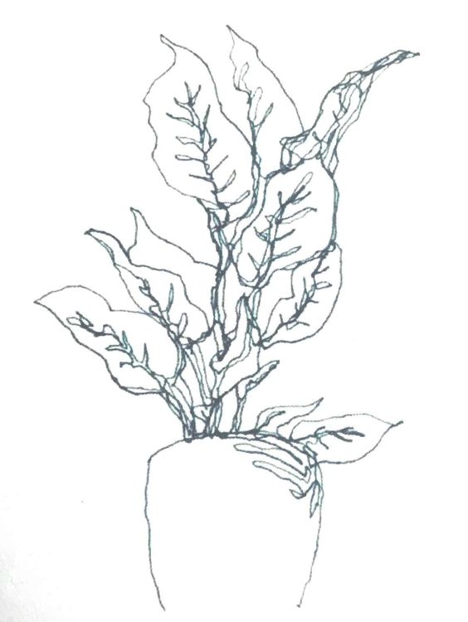
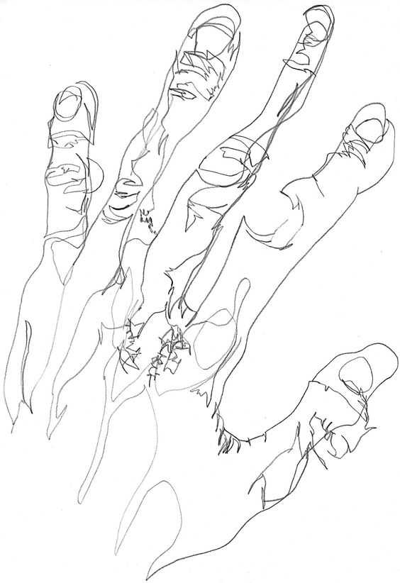
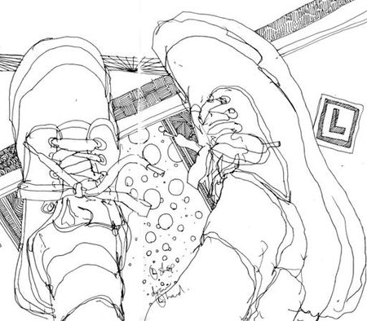
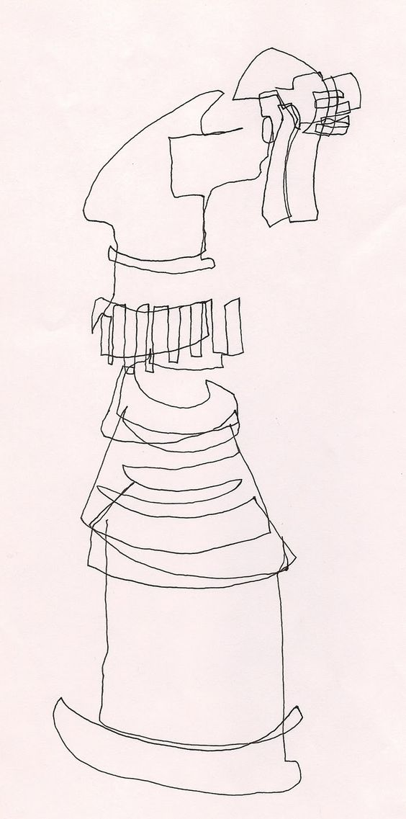
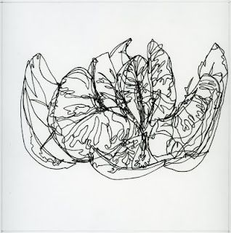
Your first task is to produce a pen drawing of an object using continuous line.
Be brave, don’t be tempted to draw the outline in pencil first. Put your pen on the paper and just keep drawing until you’ve finished.
To do this you’ll either need to go back over the lines you’ve already drawn or just draw a line that connects up to the part you’re working on next.
We’re looking for a lively energetic drawing. Have fun!

Slide 3
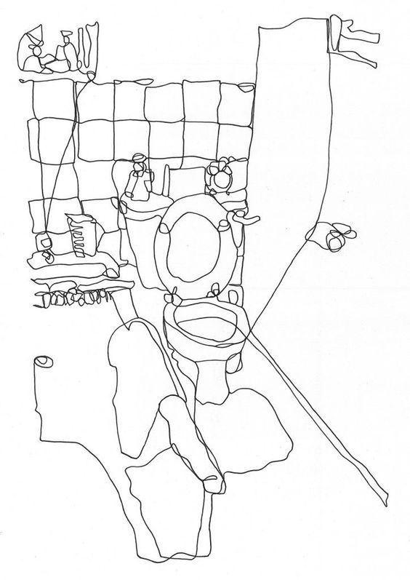
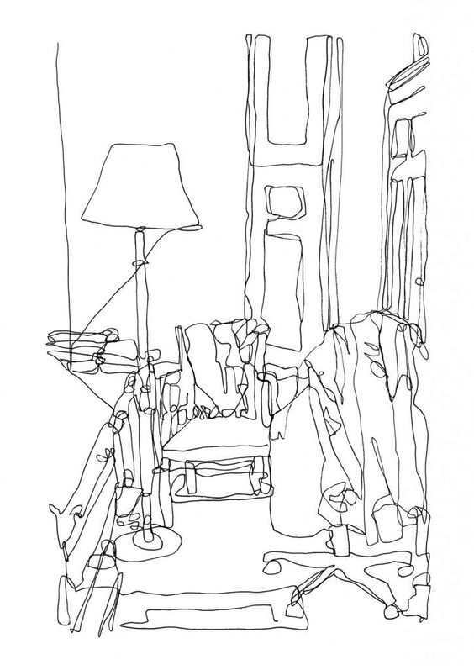
Right
Task 2 –
Now that you’re (hopefully!) a bit braver you’re going to use the same technique to draw one of the rooms in your home.
Remember we’re looking for a lively energetic drawing using one continuous line from start to finish.
Look how this artist just moves the pen to the next section of the drawing. They don’t take the pen off the paper.

Slide 4
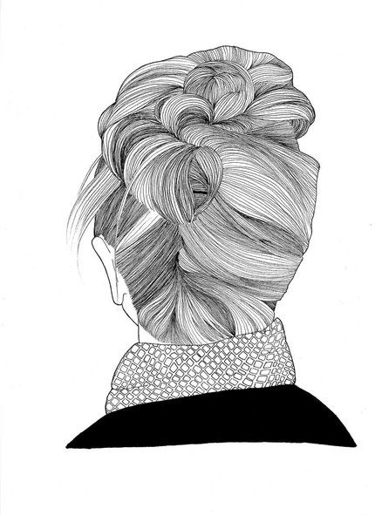
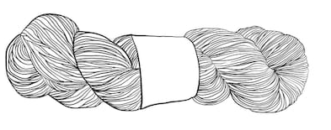
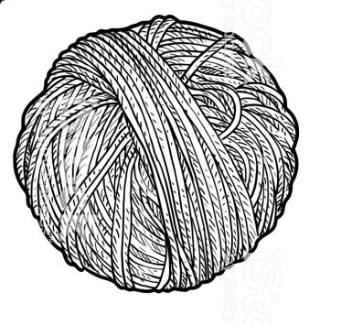
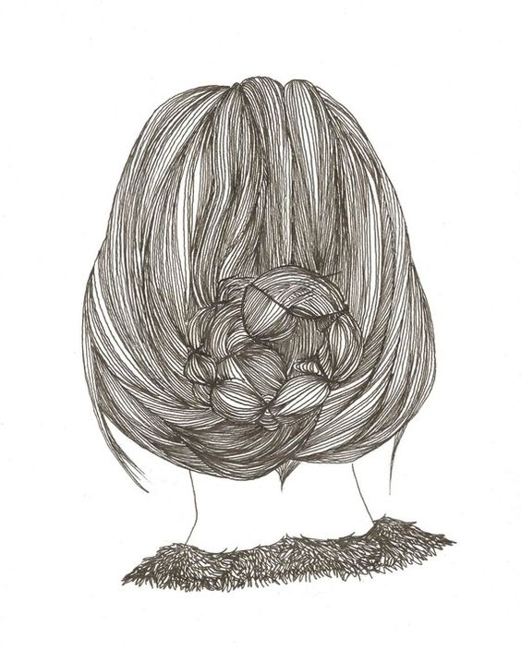
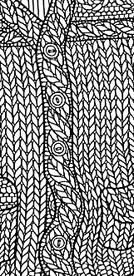
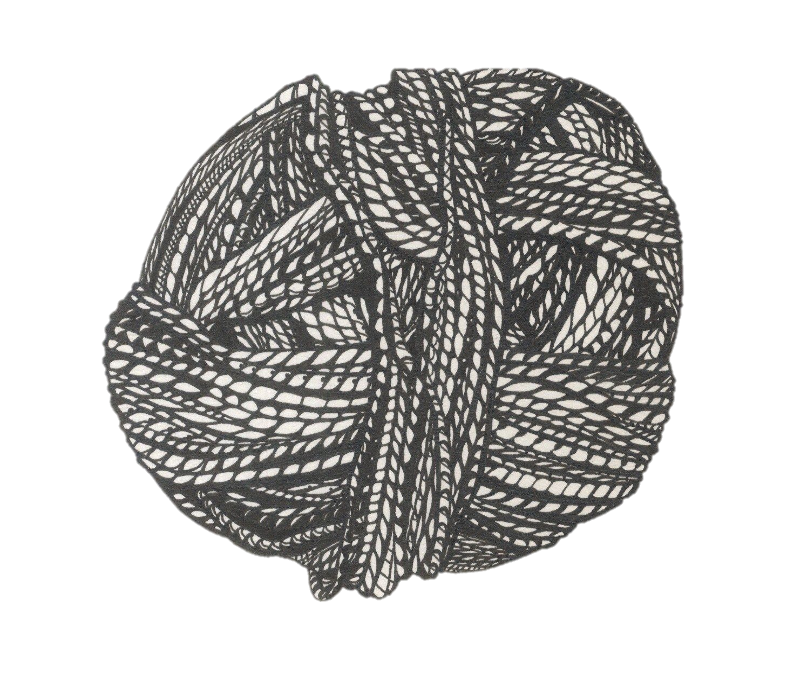
For the third drawing task we want you to go to the other extreme and produce a tight detailed drawing.
Ideas for objects to draw:-
Close up of a knitted jumper or cardigan
Hair
A ball of wool or string
For this drawing you’re allowed to draw the outline and basic details very lightly in pencil. Then work in pen to add the details.
For this task we’re looking for precision and detail.

Slide 5
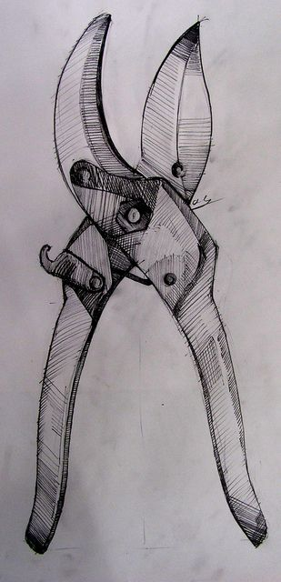
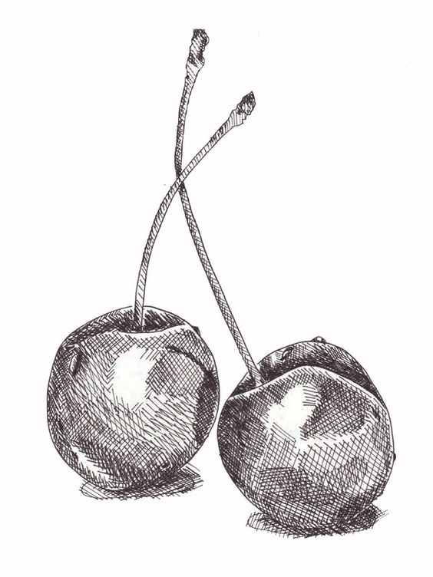
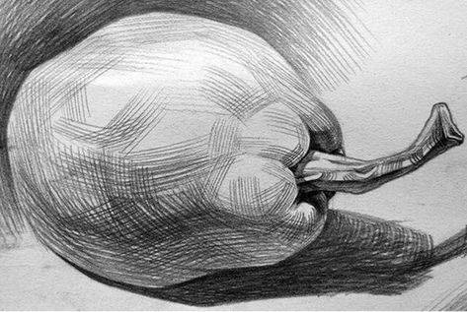
Your fourth task is produce a tonal drawing of an object.
When adding the tones you should only use straight lines. To make the drawing darker you can put the lines closer together or draw cross-hatching lines that go in the opposite direction.

Slide 6
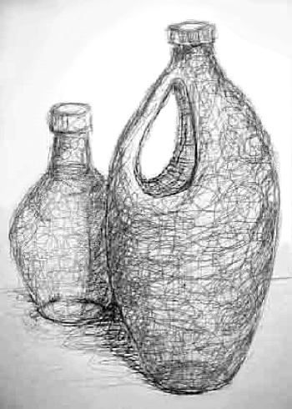
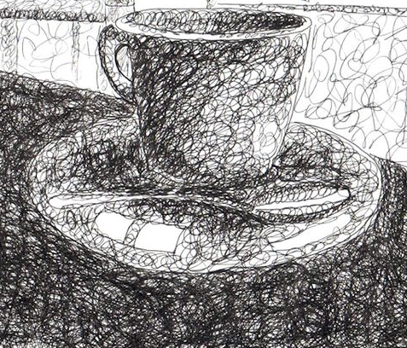
Your fifth and final task requires you to loosen up again.
First find a couple of plain objects (no patterns or labels) and do an outline pencil drawing of them.
Then working in pen add the tones using a loose circular motion.
Don’t get too carried away – remember that some areas will be very light so you need to press on lightly and build up the darker areas gradually.
Remember to squint your eyes when you look at the objects and your drawing so that the position and darkness of the shadows are more obvious.

