Slide 1

Spanish A level – L6
Curriculum Intent
The Spanish department seeks to develop ambitious and resilient linguists who recognise their common humanity and strive to gain inter-cultural understanding and respect. We aim to provide an understanding of Spanish in a range of themes from social changes, global issues and history which enables students to communicate effectively in authentic situations on their exchange visits and be prepared for the challenges of developing the language at a higher level and with an aspiration to continue the language at University or to at least see its value in their future career paths. We intend to develop our students to be inquisitive and curious about Hispanic cultures, knowledgeable and understanding, open-minded and courageous as they personally develop through their learning of Spanish.
”El que lee mucho y anda mucho, ve mucho y sabe mucho” - Miguel de Cervantes
He who reads a lot, walks a lot, sees a lots and knows a lot.
Students will:
Re-cap GCSE grammar structures and will learn A level grammatical structures such as subjunctive and the passive voice.
Study changes in Spanish society
Family diversity
Co-habitation
Matrimony
Employment
Women in the workplace
Tourism
Study hispanic culture
Role of musicians
Hispanic music
The media
Gastronomy
Festivals & religion
Analysis of the film and introduction formal essay writing – El Laberinto del Fauno - Guillermo del Toro
Introduction to research skills for their Independent Research Project.
Knowledge, understanding & Skills
Vocabulary of themes covered
Response to spoken text in writing, showing understanding of the main points, gist and detail.
Response to written text in writing and speaking.
Summary of a spoken text in writing.
Translation into and from Spanish.
Discussion on a theme showing knowledge and understanding of the target language context and culture.
Developing an argument and reaching a logical conclusion.
Expressing viewpoints and justifying opinions.
Use of appropriate literary and film vocabulary.
Relating the work to key concepts, issues and the social context and writing a critical response.
How can you enhance your learning at home?
All students have access to a Spanish Sixth Form Padlet with a wealth of online resources such as Conjuguemos, ElGancho.es, El Mundo, El País and Myinterestante.es
Dynamic learning
Flipped learning
Essay bank
Zigzag resources for reading and listening comprehensions
Translation tasks
Scene analysis
Hodder Edexcel A level textbook
Hodder Study Guide – El Laberinto del Fauno
Oxford A level Spanish translation workbook
William Tweed Resources LIbrary
What does excellence look like?
Confident and accurate use of Spanish with varied vocabulary and structures, including complex language.
Critical analysis of issues, themes and cultural or social contexts demonstrated through convincing interpretations.
Consistent use of evidence to justify points of view.
Detailed, logical arguments and conclusions that consistently link.

Slide 2

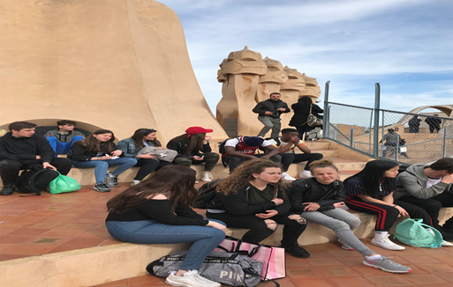
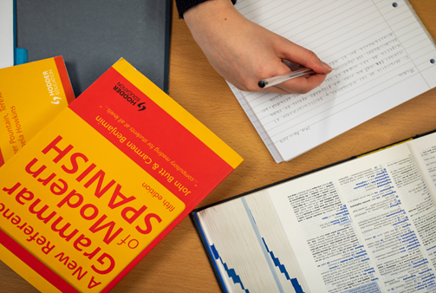
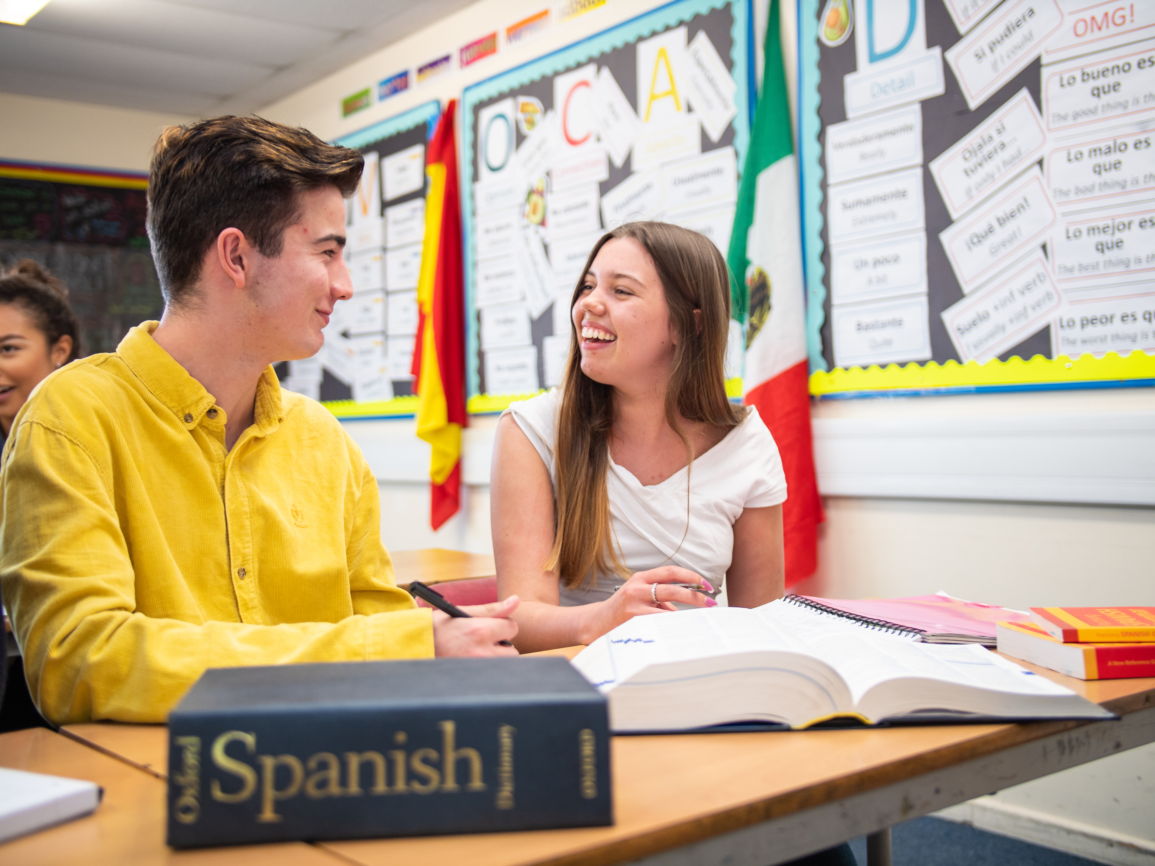
How will we assess impact?
Our teaching encourages regular learning of key vocabulary and refinement of grammatical structures that are tested regularly. Translation skills are honed via weekly 10-point tests. Teachers assess pupils less formally in class via the four skills of listening, reading, speaking and writing. Pupils work collaboratively in pairs and groups to constantly improve their speaking skills, providing peer feedback.
Each half-term pupils take an assessment in test conditions during lesson time. In June of the Lower Sixth pupils take a full-length A level-style examination, which helps to predict their final grade as accurately as possible and to offer the students an opportunity to experience the speed and attention to detail required in the examination. Students control the audio themselves for listening, within a set time limit.
Matriculation requirements
To be able to access the A-Level Spanish course, students should have gained at least a grade 6 in GCSE Spanish, or the same level in an equivalent qualification.
Visits Programme
In the Spring term of the Lower Sixth, all pupils must complete a work experience placement. We offer all students of Spanish the opportunity to undertake a two-week work placement in Madrid or Pamplona. Previous work placements have included primary schools, shops and restaurants. Pupils stay with a family to give them the maximum opportunity to improve their language skills and to better understand the culture.
This is an exchange programme so each students’ partner also stays here for two weeks, whilst completing their own work placement.
Within the curriculum
The Spanish A level curriculum is designed to deepen understanding and appreciation of Spanish-speaking culture. Themes 1, 3 & 4 focus on Spain and Theme 2 is about the music, media and festivals and traditions from all Spanish-speaking countries, from Argentina to Venezuela.
Students are encouraged to research each theme independently to ensure that they can draw on a wide knowledge of the culture and society.

