Slide 1
GCSE Food Preparation and nutrition

Slide 2
GCSE Food Preparation & Nutrition
50% exam and 50% NEA (non-examination assessment).
The exam will be 1 hour 45 minutes long.
The NEA is broken down into two sections:
  Task one – Scientific research and evaluation (15%)
  Task two – Food preparation and assessment (35%)
  The NEA will only be completed in Year 11.
Subject knowledge (Theory) is broken down into the following groups:
    Food, nutrition and health
    Food science
    Food safety
    Food choice
    Food provenance

Slide 3
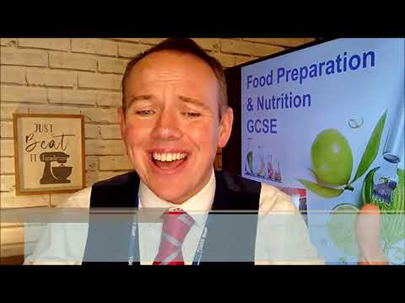
Watch the video by Fun Kitchen to find out more about the course.
We study AQA!
https://www.youtube.com/watch?v=-hI9vZsHw64

Slide 4
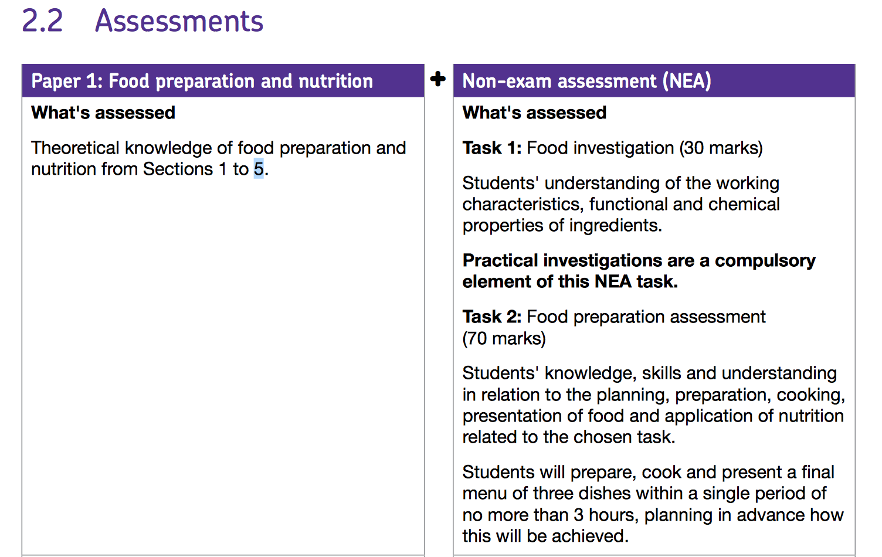
GCSE Food Preparation & Nutrition

Slide 5
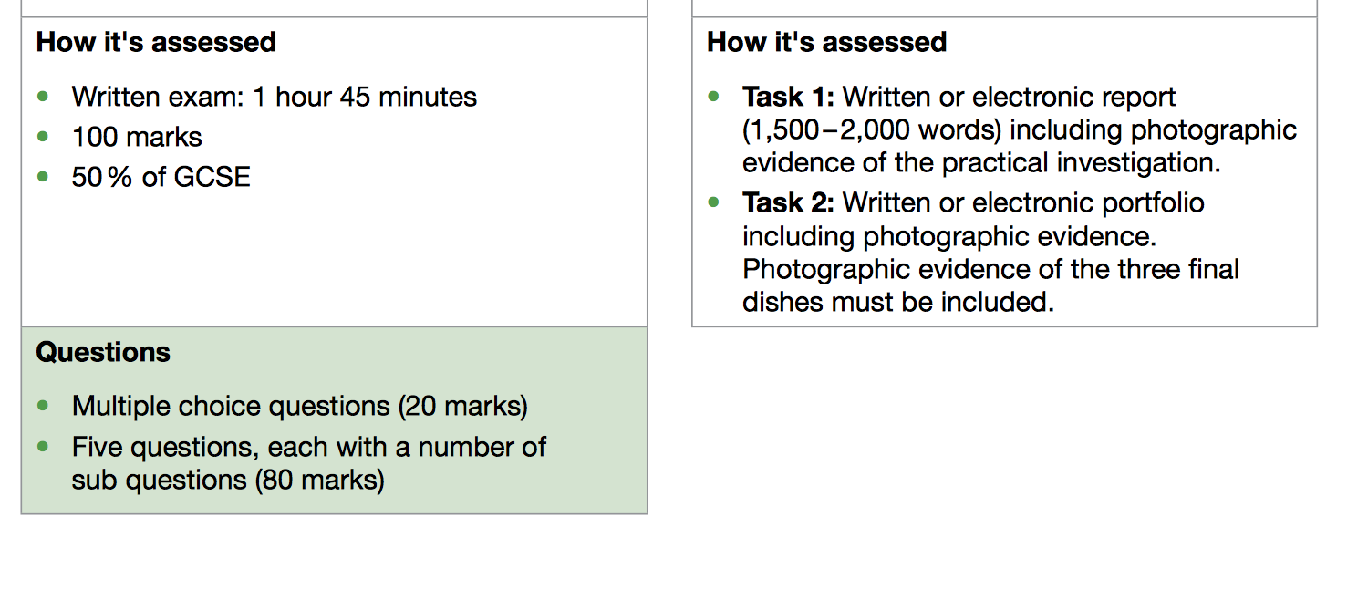
GCSE Food Preparation & Nutrition

Slide 6
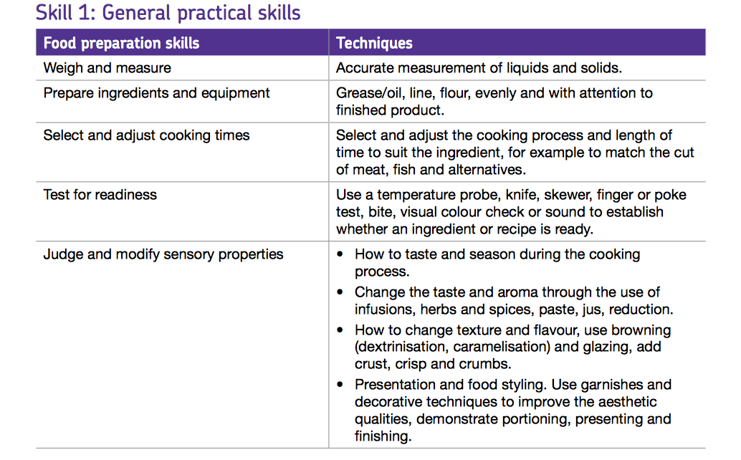
GCSE Food Preparation & Nutrition
Skills required:
Mainly through year 10 you will need to be able to show a knowledge and ability to complete the following skills.
These will be needed for your exam and NEA.

Slide 7
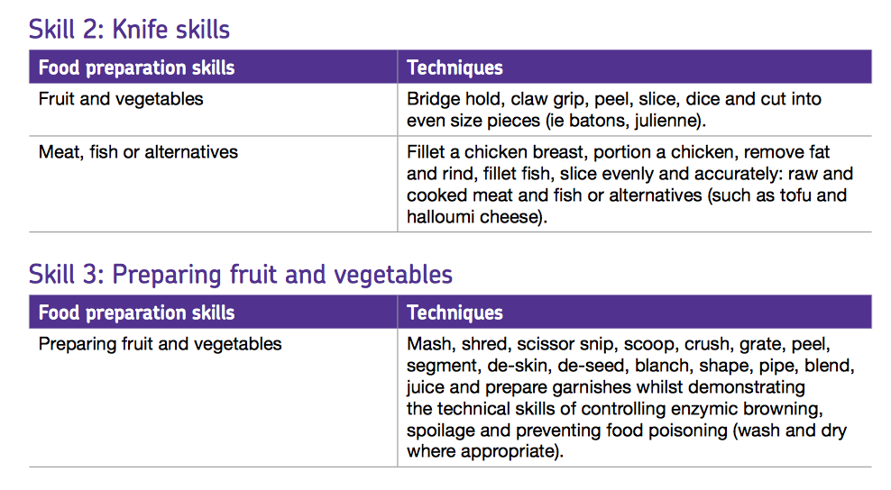
GCSE Food Preparation & Nutrition

Slide 8
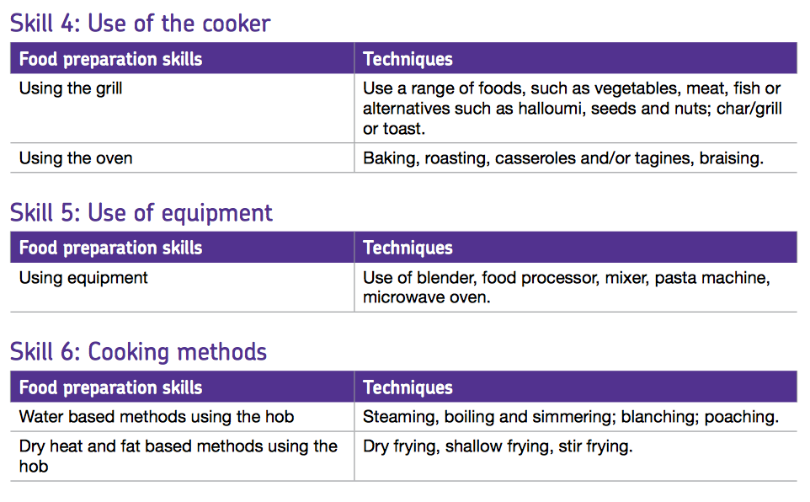
GCSE Food Preparation & Nutrition

Slide 9
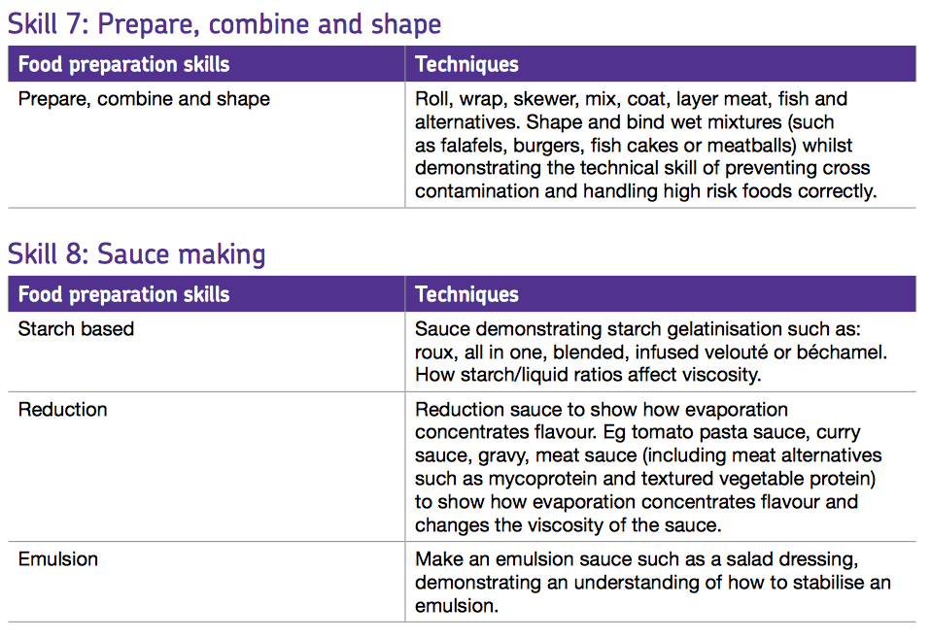
GCSE Food Preparation & Nutrition

Slide 10
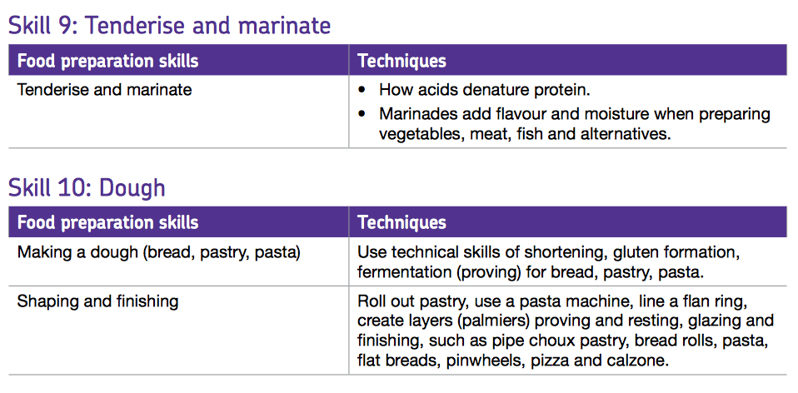
GCSE Food Preparation & Nutrition

Slide 11
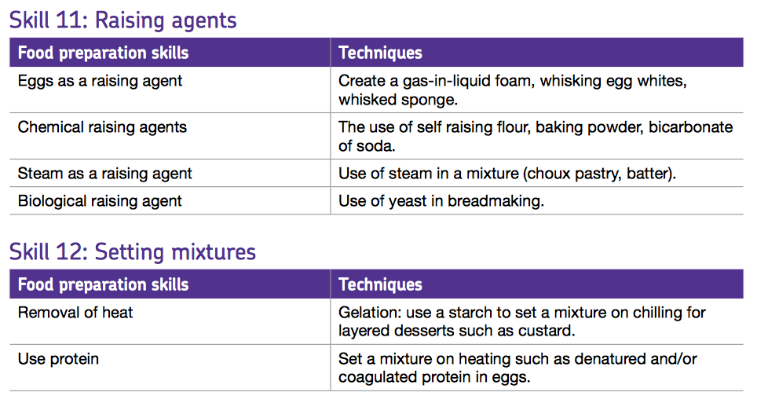
GCSE Food Preparation & Nutrition

Slide 12
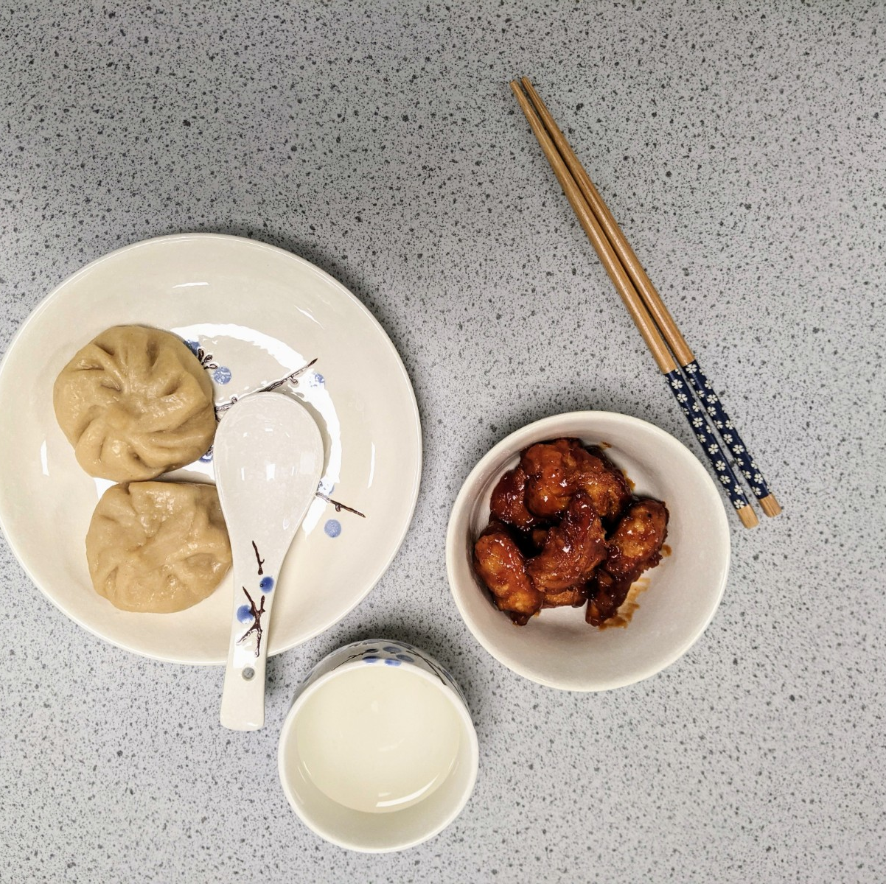
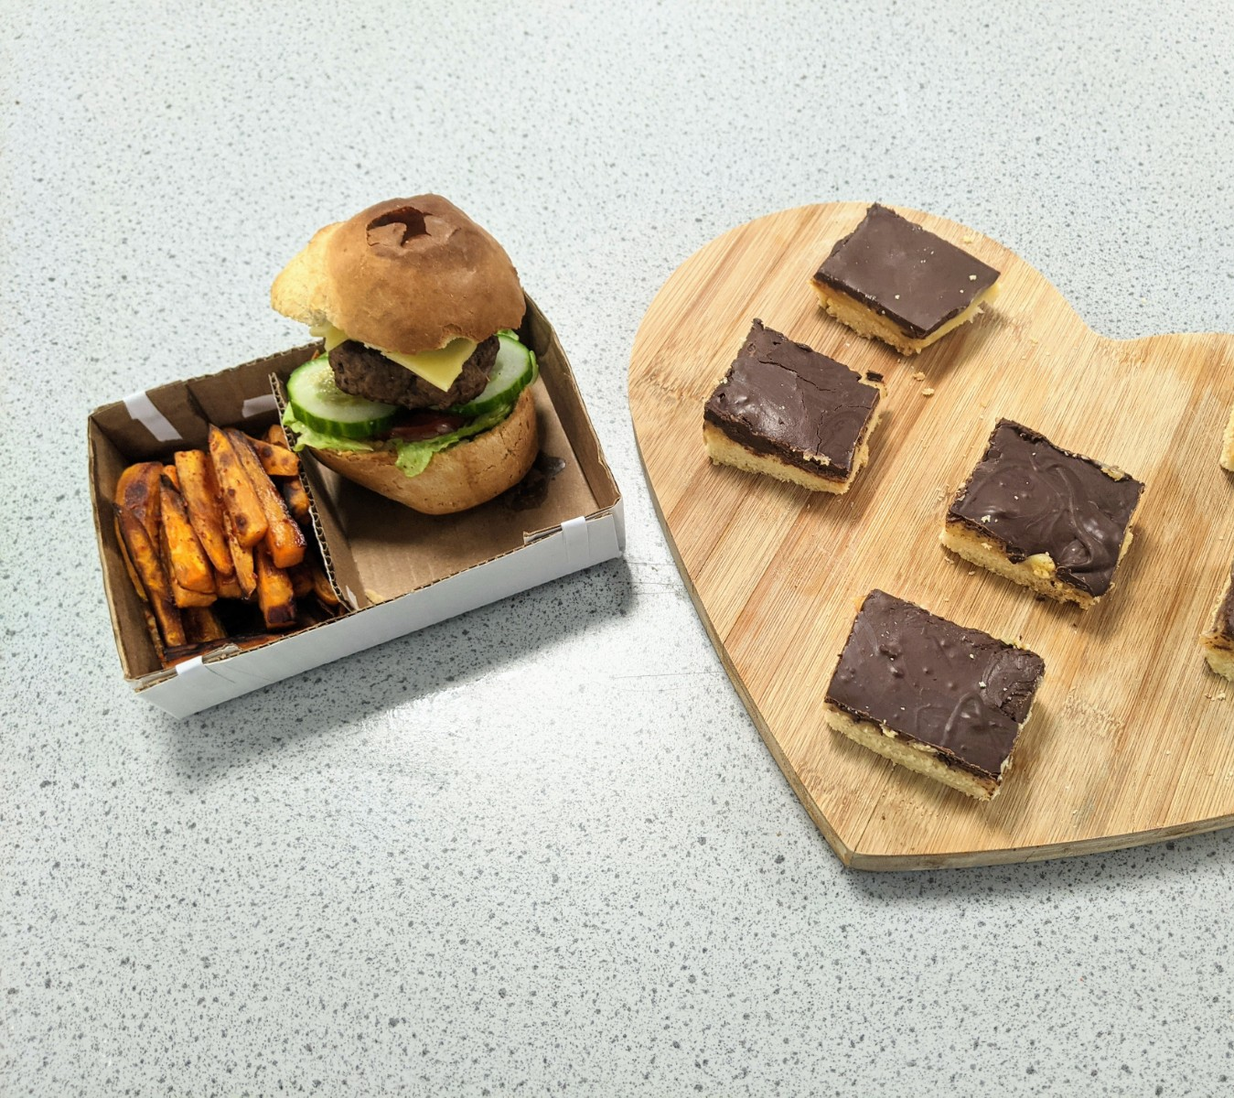
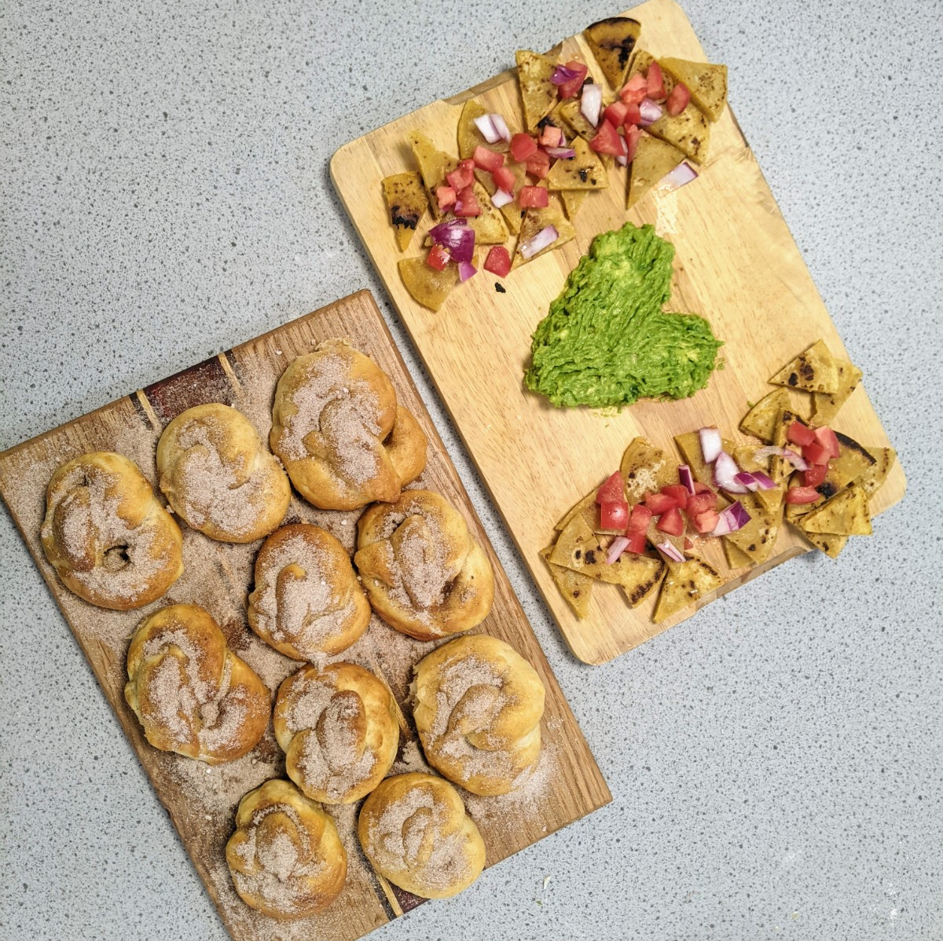
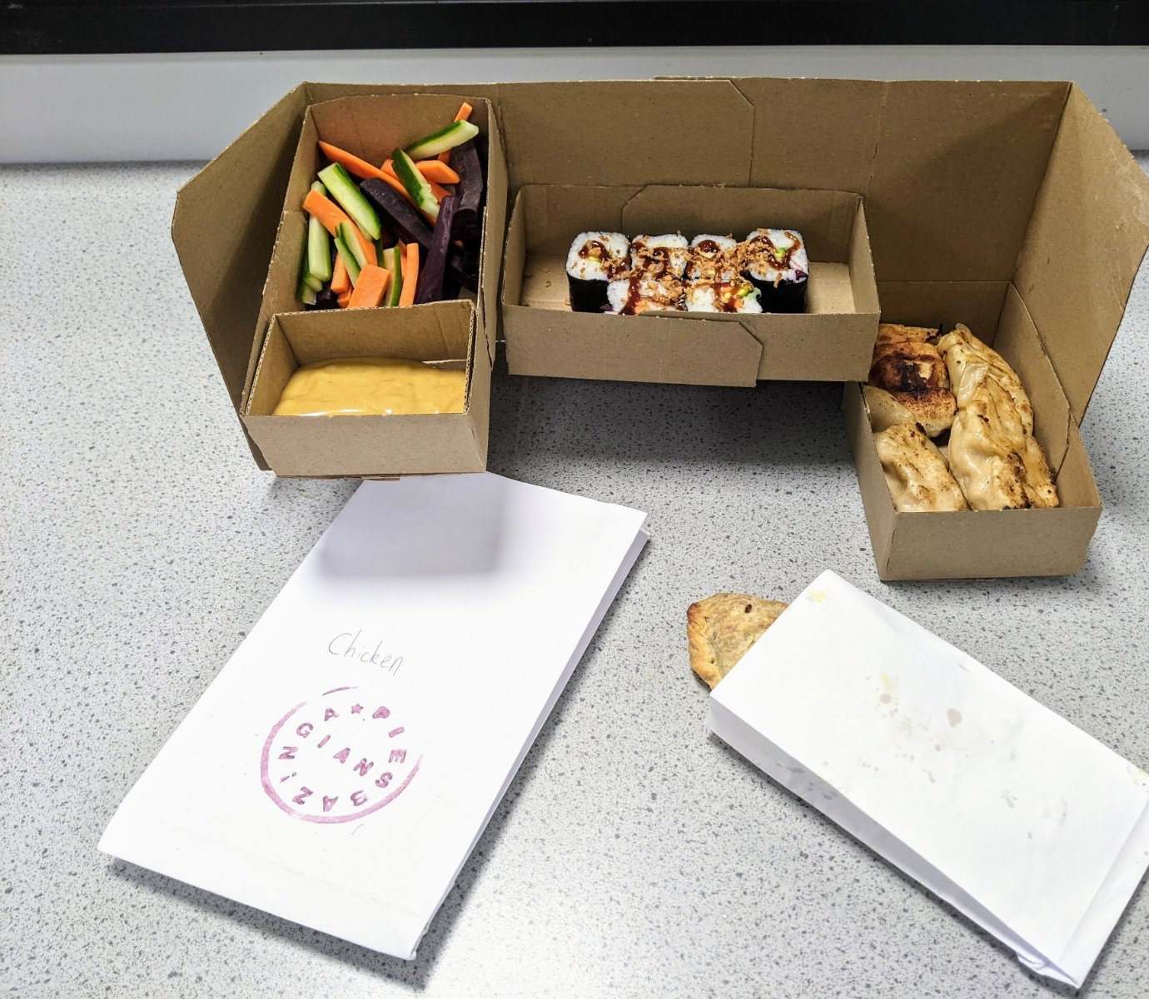
Student work

Slide 13
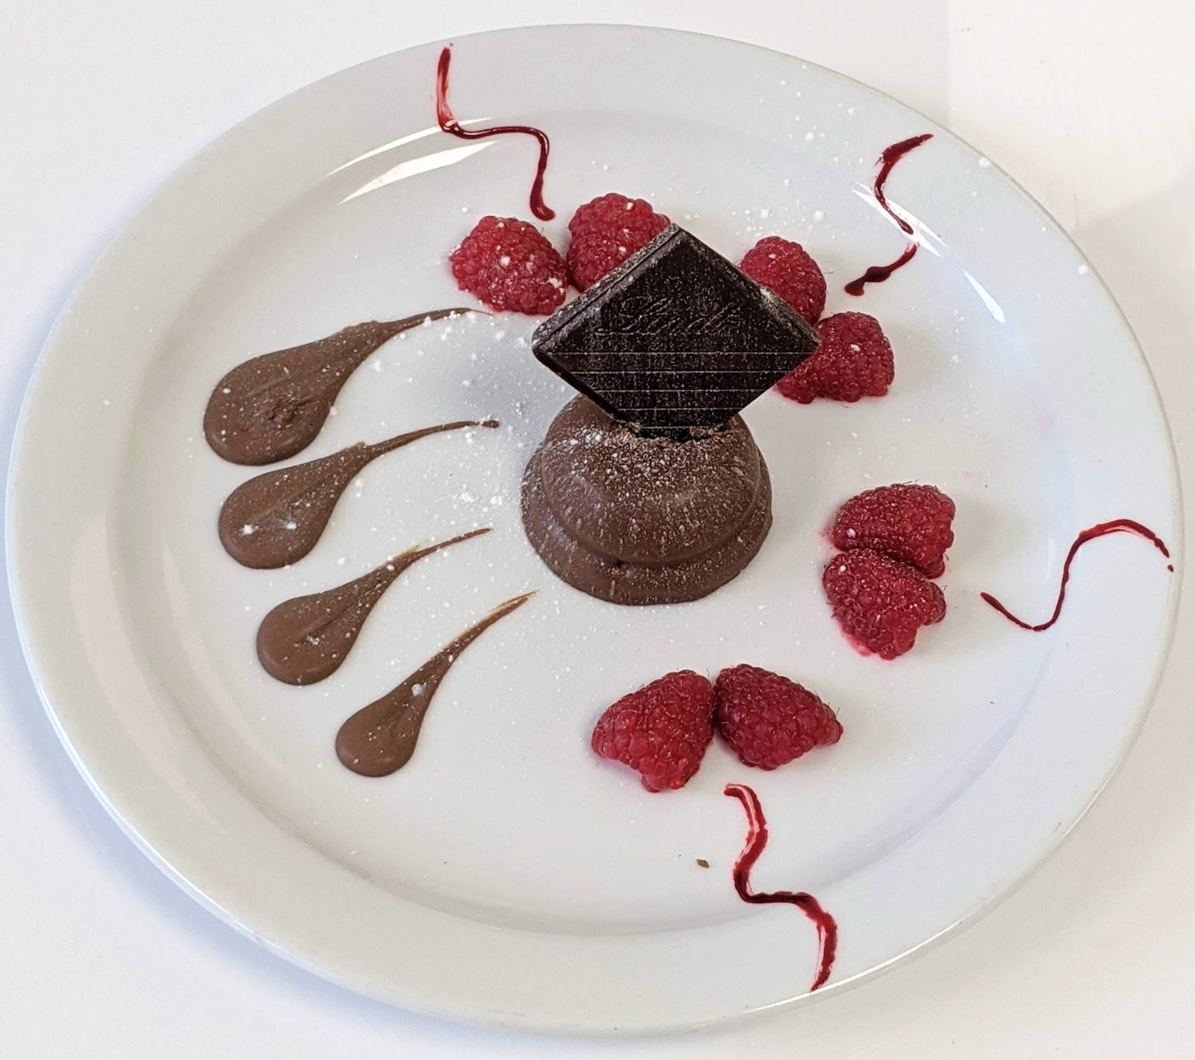
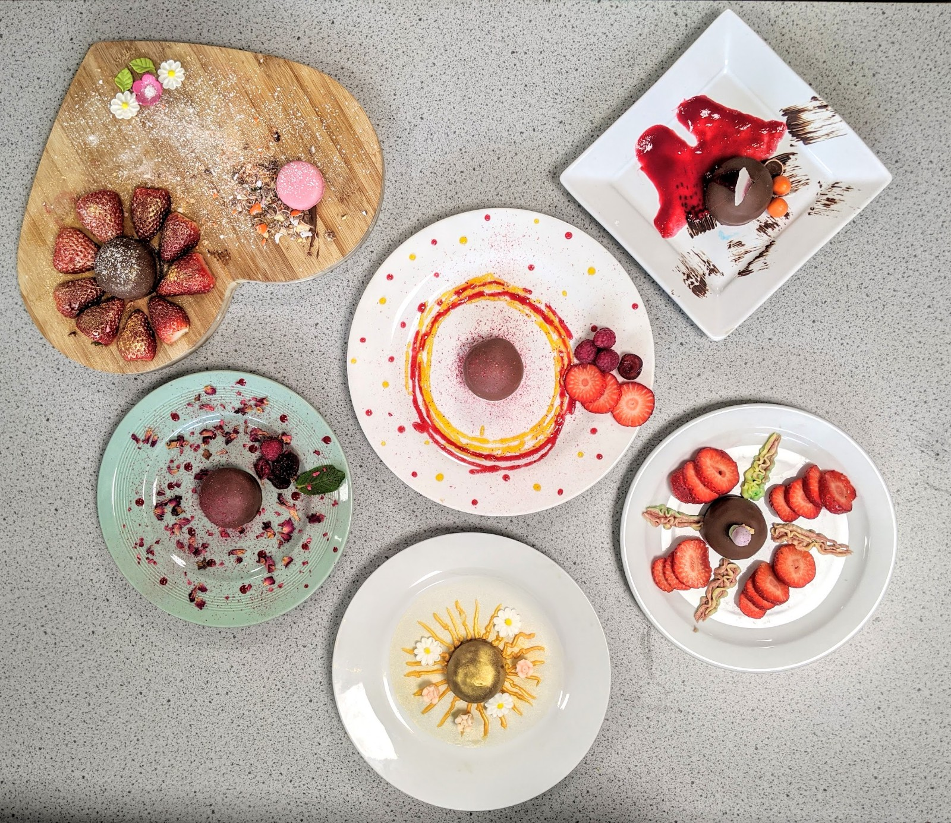
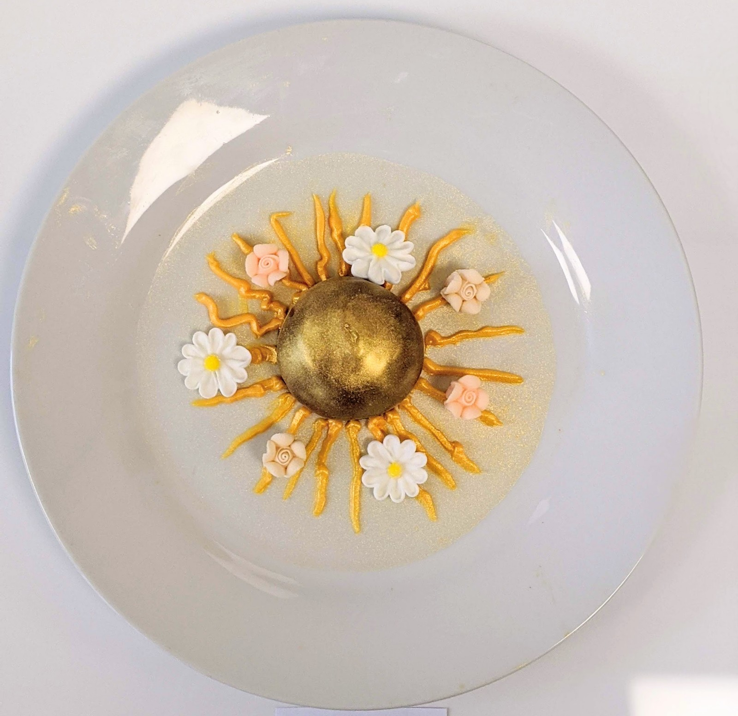
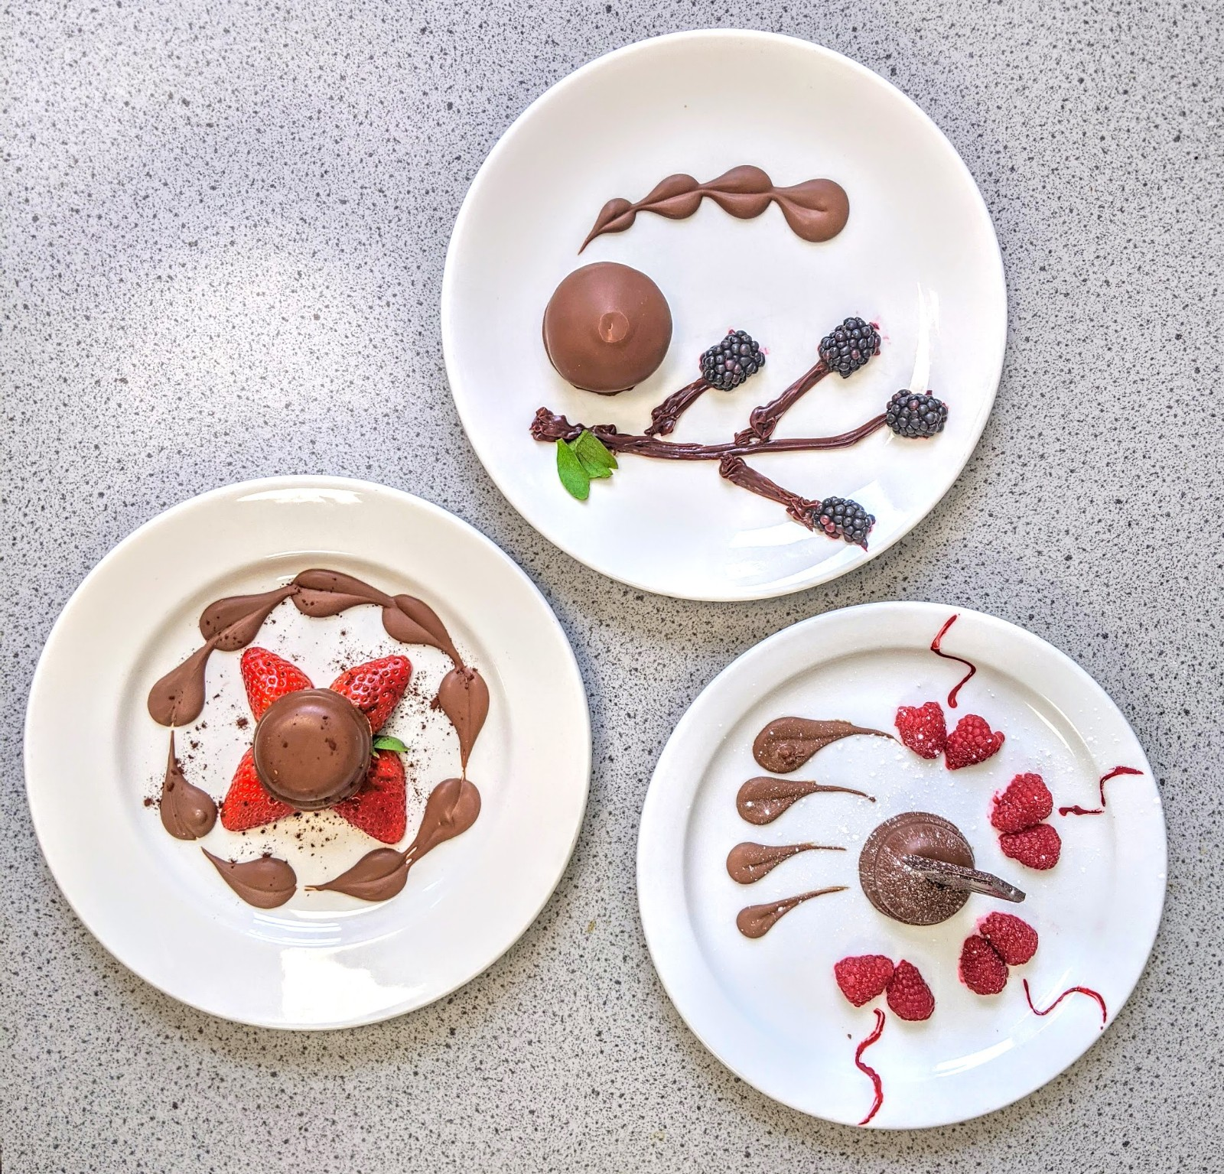
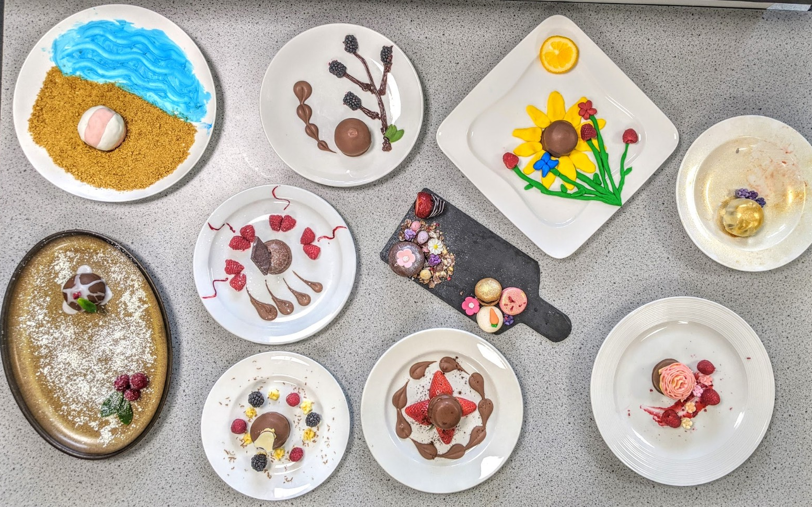
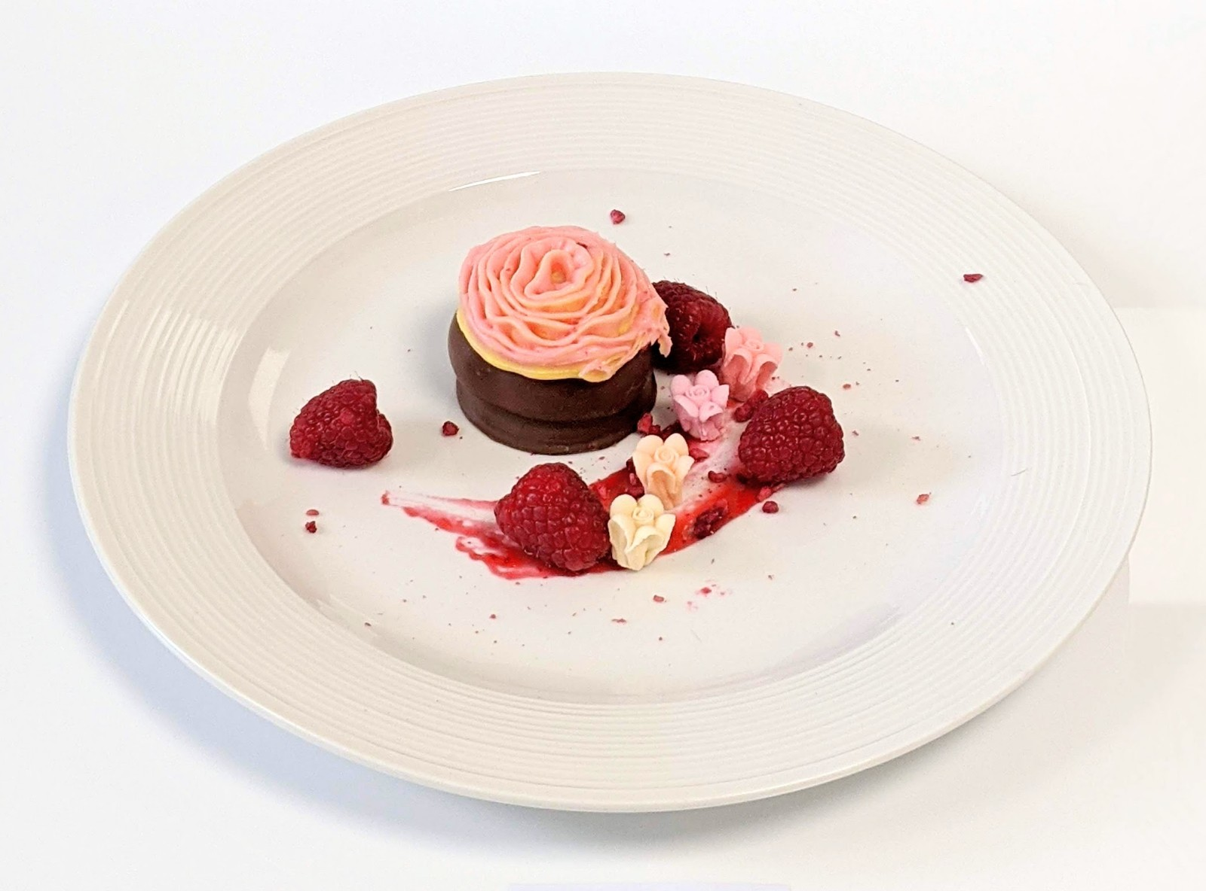
Student work

Slide 14
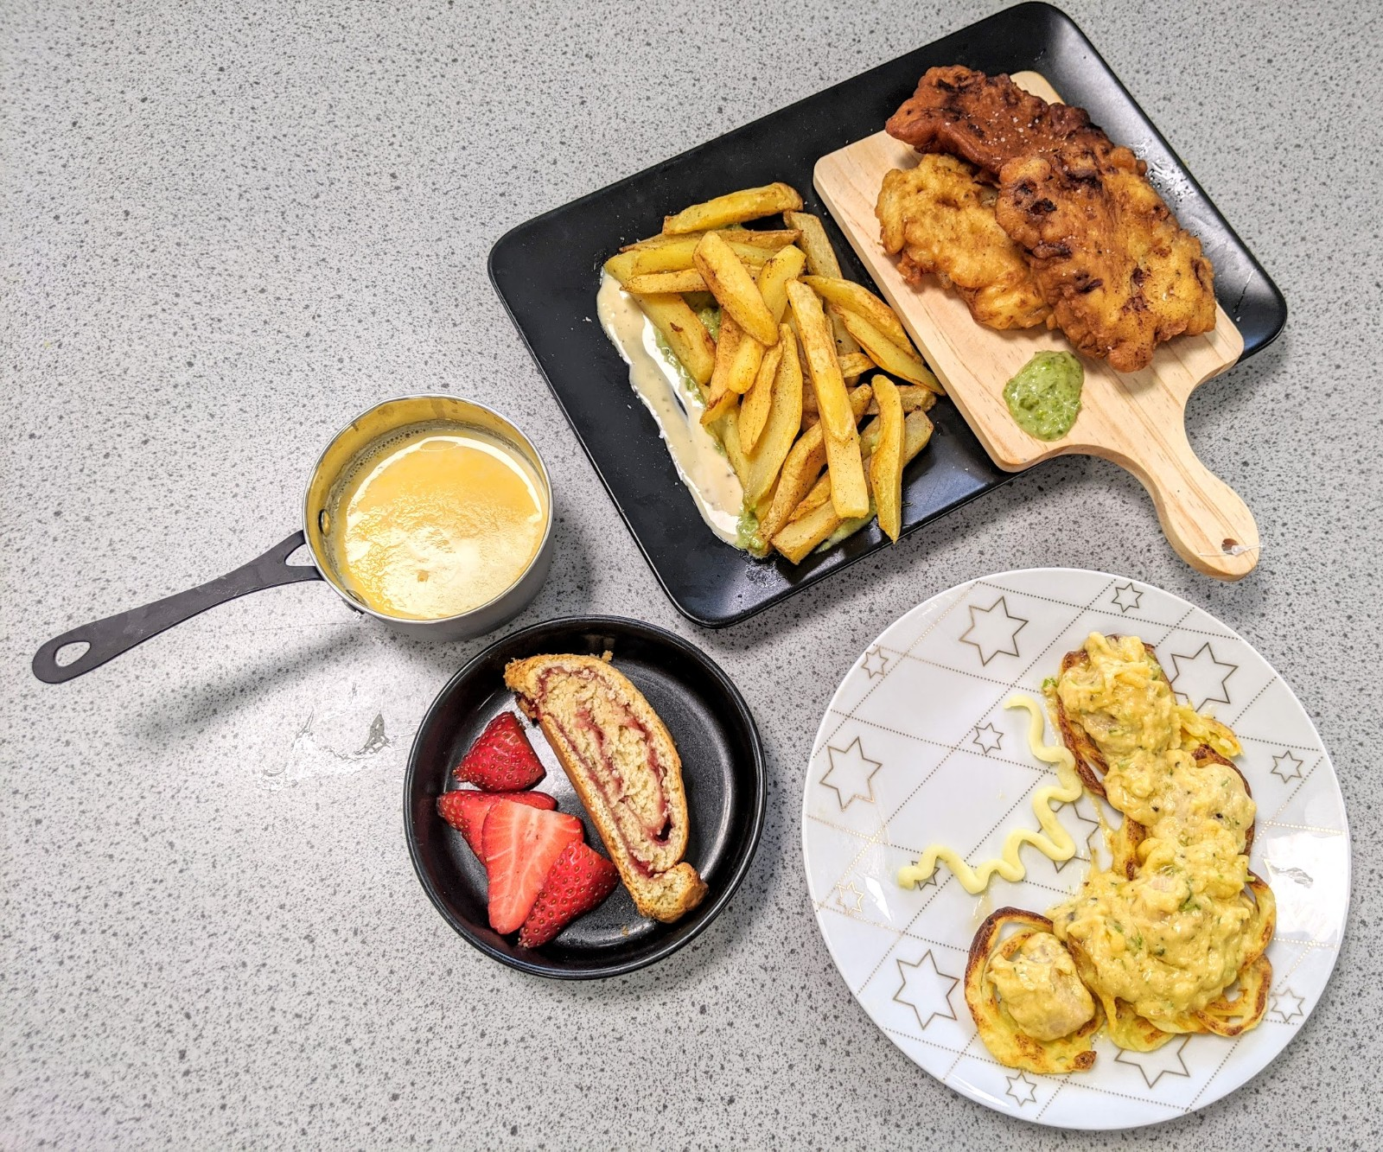
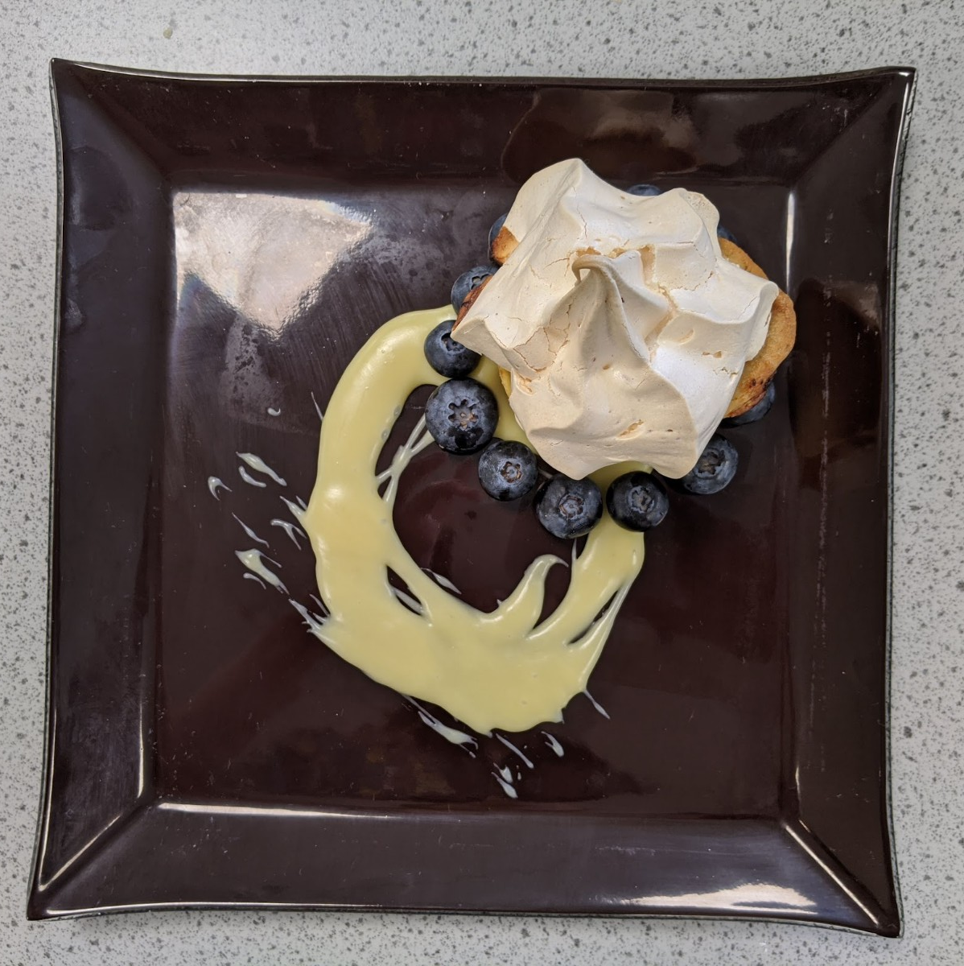
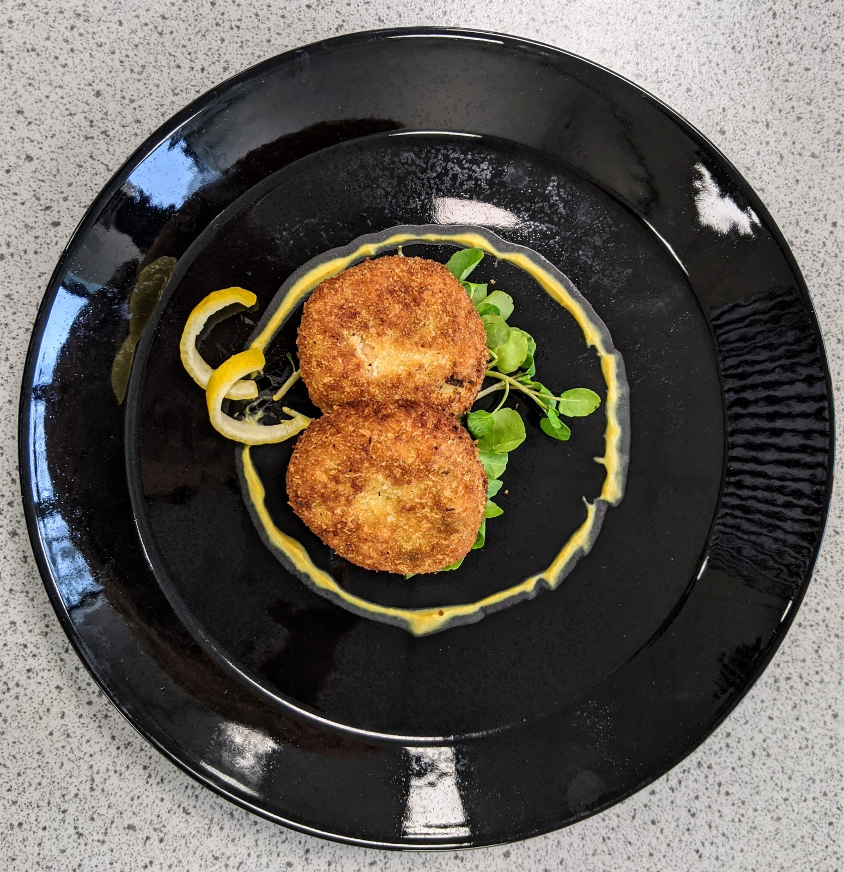
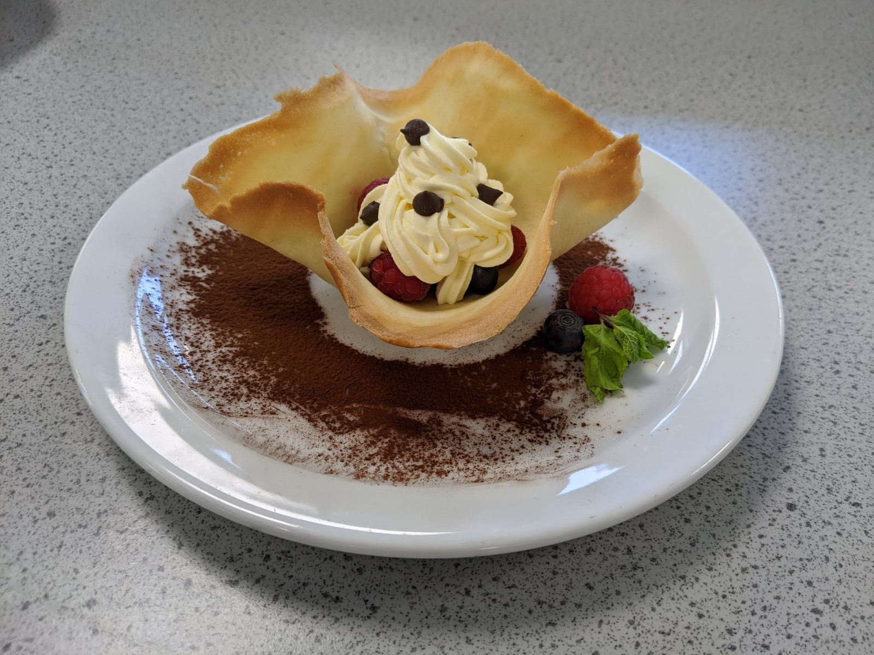
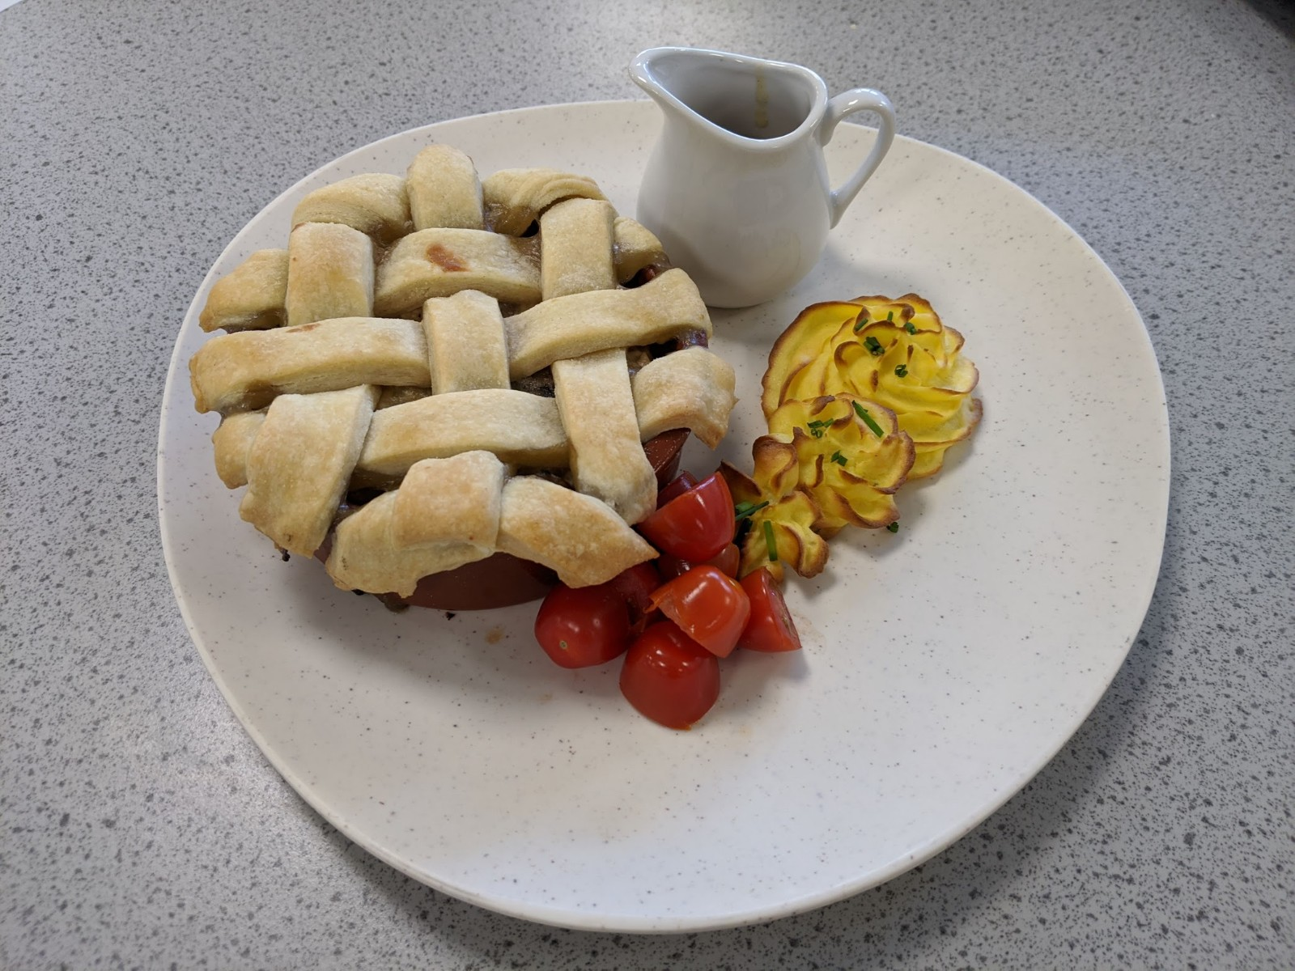
Student work

